Slide 2
Tommaso Galli
European Urban Initiative Permanent Secretariat

Slide 3
1
Urban Innovative Actions
2014-2020
2
What is the European Urban Initiative?
Summary
3
Funding Opportunities
4
First Call for Proposals
5
What else does EUI offer?

Slide 4
Urban Innovative Actions
2014-2020

Slide 5
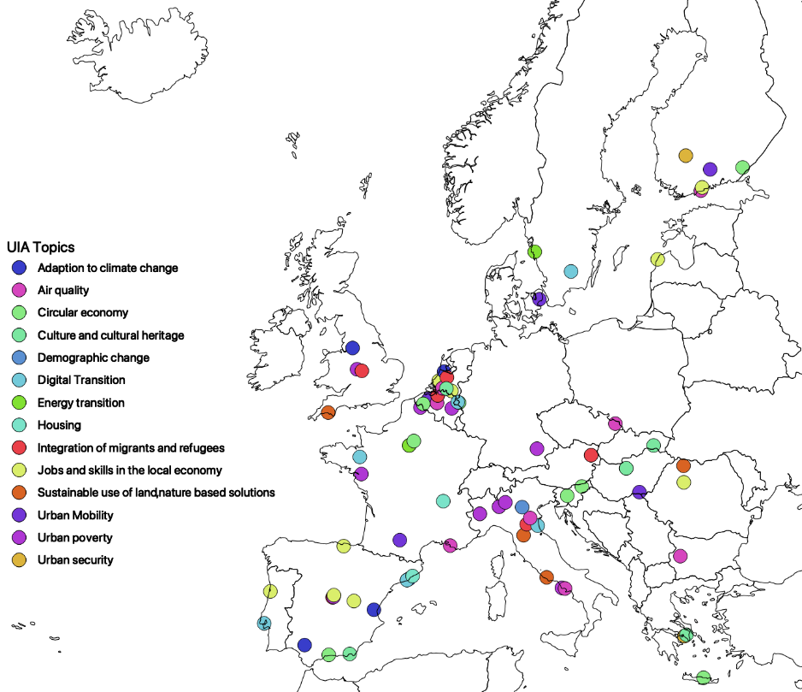
Urban Innovative Actions
The “Urban Lab of Europe”
Art.8 ERDF: “…To identify and test new solutions which address issues related to sustainable urban development and are of relevance at Union level.”
To provide urban authorities with resources to test how new and unproven solutions work in practice and how they respond to the complexity of real life.
86 approved projects from 19 member states and the UK
EUR 372 Mio committed
5 calls completed

Slide 6
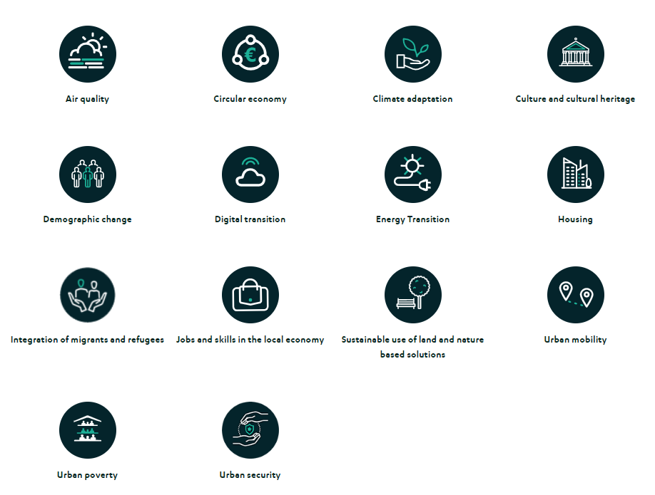
Urban Innovative Actions
Topics

Slide 7
WHAT IS THE EUI?
About the Initiative

Slide 8
The 2021-2027 Cohesion Policy legislative package includes the establishment of the EUI as an EU instrument, the successor to the Urban Innovative Actions implemented during the 2014-2020 programming period.
EUI is a European Union instrument and is managed by the European Commission's DG Regional and Urban Policy.
EUI has a total ERDF budget of €450 million for 2021-2027.

Slide 9
THE INITIATIVE HAS BEEN CREATED
in order to
FUNDING FOR INNOVATIVE PILOT PROJECTS
identify and test INNOVATIVE, TRANSFERABLE AND SCALABLE solutions to sustainable urban development problems of particular relevance at EU level
building the capacity of cities to implement innovation
disseminating information on best practices from implemented projects and developing the knowledge gained from their experience
MEASURES TO SUPPORT CITIES' CAPACITY TO INNOVATE
ACTIVITIES AIMED AT DISSEMINATING AND EXCHANGING KNOWLEDGE

Slide 10
FUNDING OPPORTUNITIES
Key information on EUI grants

Slide 11
1
Innovative projects (new, untested solutions in Europe) with the potential to be replicated in other European cities
2
Support of up to EUR 5 million ERDF
(maximum co-financing rate of 80%)
3
Beneficiaries: urban authorities (associations or groupings of urban authorities) with a total population of more than 50 000 inhabitants
4
Implementation period: 3.5 years
(+ 6 months of Project Initiation Phase and 3 months for administrative closure of activities)
5
Thematic scope of support: each time defined by the European Commission and based on themes identified in the Urban Agenda for the EU;
First call for proposals: New European Bauhaus

Slide 12
EUI SUPPORTS PROJECTS, which are:
INNOVATIVE
HIGH QUALITY
PARTICIPATORY
MEASURABLE
SUSTAINABLE AND SCALABLE
TRANSFERABLE
Implemented in partnership. Prepared with a leading role for the city as a strategic partnership leader. Planned to achieve the goals of local strategies and policies. In line with the spirit of the principles of good urban governance according to the New Leipzig Charter.

Slide 13
New component of EUI projects:
TRANSFER
international partnership - 3 partner "transfer cities"

Slide 14
FOR LEADER CITIES: AN OPPORTUNITY TO SPREAD INNOVATION FOR PARTNER CITIES: A CHANCE TO BENEFIT FROM THE EUI OFFER
The aim is:
Observing (i) the implementation process of an urban innovation, (ii) the testing of a pilot solution
Exchange of knowledge and experience
Preparation for possible adaptation (and subsequent implementation) of the pilot solution to local conditions
Budget: 120 000 ERDF per city (+ own contribution required)
Funded: study visits, workshops, meetings, expertise, analyses, mini pilot actions
Expected outputs: self-evaluation at the beginning and at the end of the cooperation; feasibility analysis of the pilot solution

Slide 15
FIRST CALL FOR PROPOSALS Autumn 2022

Slide 16
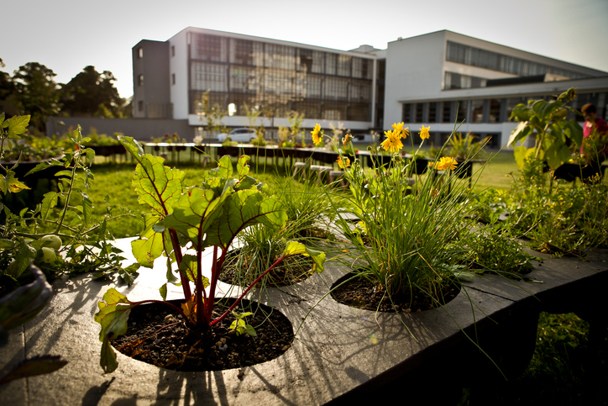
NEW EUROPEAN BAUHAUS (NEB)

Slide 17
UNDER THE FIRST CALL, EUI WILL FINANCE PROJECTS WHICH ARE EXAMPLES OF NEB INTERVENTIONS AND
WHICH TAKE INTO ACCOUNT THE THREE BASIC VALUES OF NEB:
Beauty: are aesthetically pleasing, but also inspired by art and culture, responding to needs and improving the quality of experience and sensation beyond mere functionality.
Sustainable development, compatibility with nature, the environment and our planet.
Integration, encourage dialogue between representatives of different cultures, disciplines, genders and ages.

Slide 18
Cities are encouraged to submit proposals relating to the following subjects:
1
Construction and renovation in the spirit of circularity and carbon neutrality
2
Preservation and transformation of cultural heritage
3
Adaptation and conversion of buildings for affordable housing solutions
4
Regeneration of urban spaces
www.urban-initiative.eu

Slide 19
PRACTICAL INFORMATION
Total budget: ERDF 50 million
1st CALL EUI-IAs opened on 10/10/2022 and closes on 19/01/2023 at 2PM CET
Indicative timeline:
(a) Eligibility check: January – February 2023
(b) Strategic assessment: March – April 2023
(d) Operational assessment: May – June 2023
(d) Announcement of approved projects: July 2023

Slide 20
PRACTICAL INFORMATION
4 on-site seminars: Brussels (19/10), Vienna (8-9/10), Sofia, Vilnius (https://www.eui-applicantseminars.eu/en/page/welcome/)
3 thematic on-line seminars
Individual consultations
Q&A on EUI website

Slide 21
WHAT ELSE DOES EUI OFFER?
Other components of the Initiative & next calls

Slide 22
KNOWLEDGE BASE PLATFORM
CONFERENCES, SEMINARS
TRAININGS
CITY NETWORKING EVENTS
TRANSFER NETWORKS (IN COOPERATION WITH URBACT)
www.urban-initiative.eu/
www.uia-initiative.eu
FURTHER CALLS FOR PROPOSALS
3 further calls in 2023 and 2024
Topics successively announced by the European Commission and communicated on the EUI website

Slide 23
Thank you for your attention!

