Slide 1
Housing Europe Meetings
European Federation for Public, Cooperative and Social Housing

Slide 2
French new Environmental Standard (RE2020) for building

Slide 3
French new Environmental Standard (RE2020) for building
01
PART
Presentation

Slide 4


French new Environmental Standard (RE2020) for building
Partie 1
Presentation
Ambitious national goals
Loi Energie-Climat
Notes:
France is committed to tackle global warming and has put in place an ambitious Strategic Plan and legal frameworks.
We can quote the Low carbon Strategy, the law on green growth, the Energy-Climate law (under debate in Parliament) etc.

Slide 5
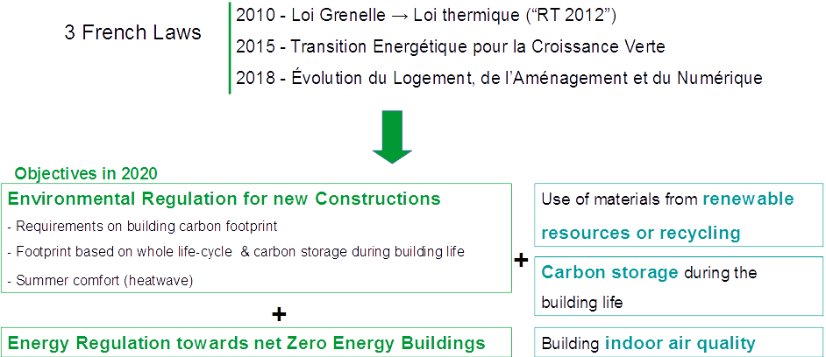
French new Environmental Standard (RE2020) for building
Partie 1
Presentation
Notes:
Since 2010, 3 different laws introduced, for new constructions, the principles of an environmental regulation and the goal of net zero energy buildings.
As a result, the French building code plans that in 2020 there will be requirements on building carbon footprint, based on a life cycle analysis and taking into account the carbon storage during the building life.
It also plans requirements on the use of products from renewable resources and recycling, on carbon storage and indoor air quality.

Slide 6
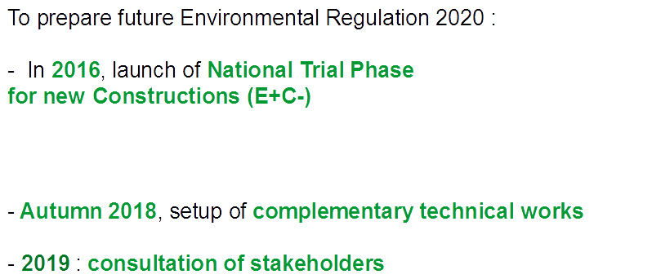

French new Environmental Standard (RE2020) for building
Partie 1
Presentation
Notes:
In order to prepare the future environmental regulation for 2020, France launched in 2016 a national trial phase for new constructions, called « E Plus C Minus »
And we set up this Autumn complementary technical works that will be followed by a consultation of the stakeholders.

Slide 7
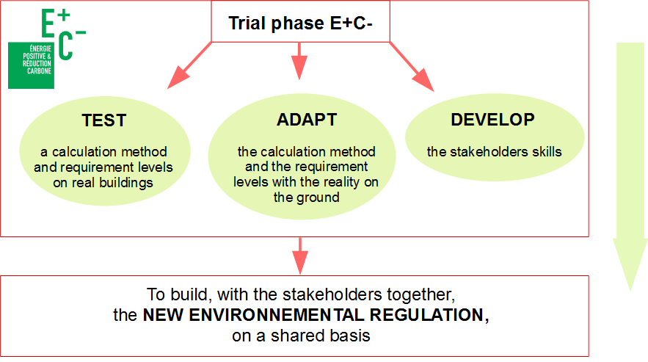


French new Environmental Standard (RE2020) for building
Partie 1
Presentation
Notes:
So, what are the objectives of this trial phase E+C- ?
First, in 2016 we created, with the stakeholders together, a common and shared calculation method and levels for energy and carbon. Then until today, we have TESTED it on real buildings (more tan 600 today have tested this calculation method).
Then second, from this feedback, we will ADAPT the calculation method and the requirements levels with the reality on the ground.
And third, in parallel, we have created tools to DEVELOP the stakeholders skills (project managers, engineering consultants, industrials, architects, construction companies) in particular about the lifecycle analysis.
These 3 steps are for us necessary to build a new environmental regulation, that will be adapted with the reality on the ground

Slide 8
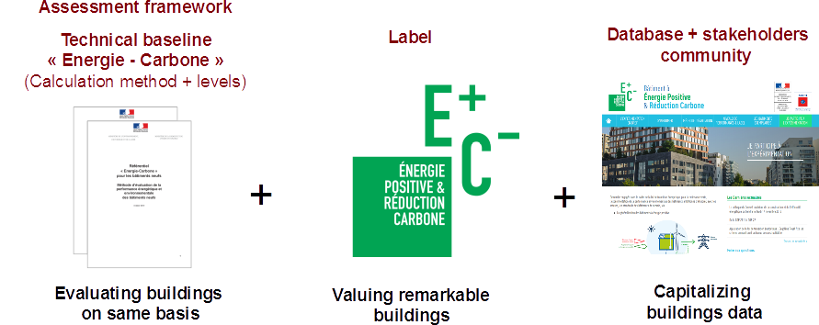
French new Environmental Standard (RE2020) for building
Partie 1
Presentation
Notes:
The trial phase is based on 3 tools :
An assessment framework, with the calculation method and energy and carbon levels, to evaluate the buildings on a same basis;
A label to value remarkable buildings;
And an observatory, composed by a data base and a stakeholders community, to capitalize the buildings data.
Today more than 900 buildings have been assessed and brought in the database.
Single family homes are the most represented, then the collective housing. The tertiary sector, like office blocks, schools, industry buildings, are the less represented.

Slide 9
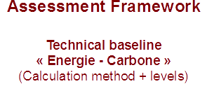
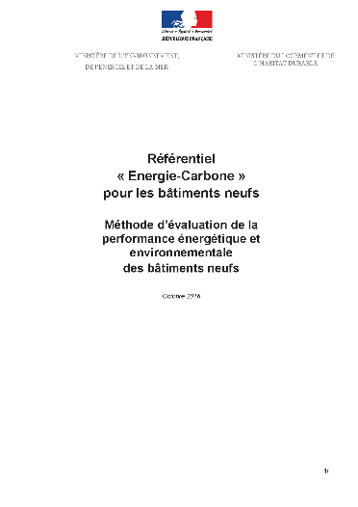
French new Environmental Standard (RE2020) for building
Partie 1
Presentation
From the energy point of view → more ambitious than current thermal regulation
Notes:
Now I would like to tell you a little more about the assessment framework, which the trial phase E+C- is based on.
The assessment framework lays down the rules for energy and environmental calculations.
From the energetic point of view, it’s more ambitious than the current thermal regulation.

Slide 10

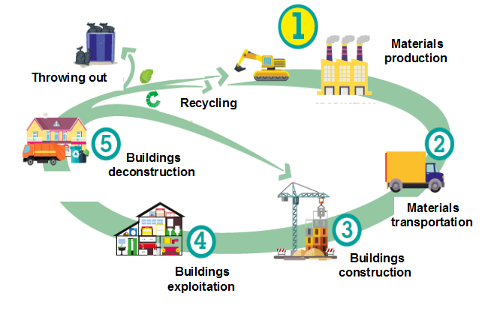
French new Environmental Standard (RE2020) for building
Partie 1
Presentation
Notes:
As regards the environmental assessment, the calculation must be based on a life cycle analysis (LCA) of the building, from cradle to grave with some specific hypothesis.
Several steps are taken into account :
the materials’ production
the materials’ transportation
the buildings construction
the buildings exploitation
and the buildings deconstruction.

Slide 11

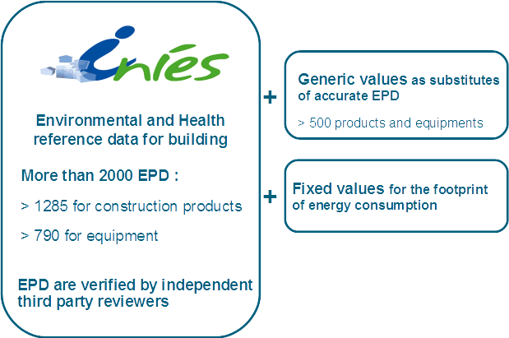
French new Environmental Standard (RE2020) for building
Partie 1
Presentation
Notes:
The calculation must use the data from the French data base called INIES that gathers Environmental Product Declarations (EPDs) of construction products and equipment, default values as substitutes when there is no EPD for the product chosen in the project and fixed values for the calculation of the environmental footprint of the consumptions of the building.

Slide 12
French new Environmental Standard (RE2020) for building
Partie 1
Presentation
Notes:
Several softwares apply the assessment framework of this trial phase.
They are linked to the database INIES to facilitate the use of EPDs. Moreover, they produce a standardized file that sums up the results of the assessment and can be dropped in the building database of the trial phase.
The reliability and quality of environmental data are essential for an ambitious and accepted by all regulation. This data must then include modular information of the construction product on the different stages of the life cycle, in particular maintenance and replacement.

Slide 13
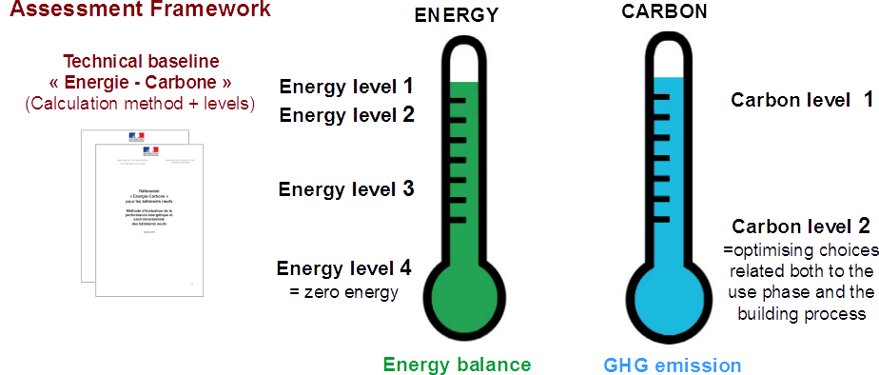
French new Environmental Standard (RE2020) for building
Partie 1
Presentation
Notes:
For this trial phase, several levels to reach were set : 4 for the energy balance indicator, 2 for the carbon emission indicator + a sub-indicator on “construction products and equipment”.

Slide 14
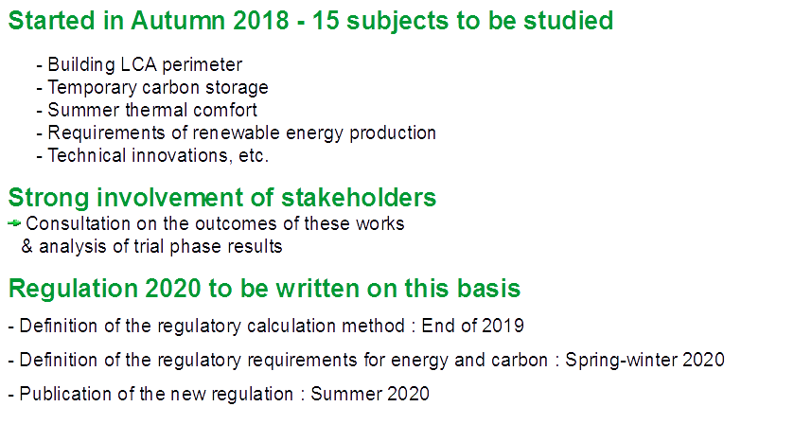

French new Environmental Standard (RE2020) for building
Partie 1
Presentation
Notes:
In addition to the trial phase « E plus C minus », some technical works have just started on 15 subjects, like the building LCA perimeter, the temporary carbon storage, the summer thermal comfort…
This work will be followed by a consultation of the stakeholders to finalize the preparation of the new regulation.
We plan to define the regulatory calculation method this Spring, then the regulatory requirements for energy and carbon this Autumn, in order to publish the new environmental regulation at the beginning of 2020.

Slide 15
French new Environmental Standard (RE2020) for building
Partie 1
Presentation
2019 : Phase de concertation sur la méthode de calcul, l'accompagnement des acteurs, l'évaluation économique et la production des données
Début 2020 : Lancement d’une phase de simulation pour tester plusieurs indicateurs et niveaux de performance
Printemps 2020 : Phase de concertation sur les indicateur et exigences de la RE2020
Automne 2020 : Publication des textes réglementaires
1er Janvier 2021 : Entrée de la vigueur de la RE2020
Notes:
France is committed to tackle global warming and has put in place an ambitious Strategic Plan and legal frameworks.
We can quote the Low carbon Strategy, the law on green growth, the Energy-Climate law (under debate in Parliament) etc.

Slide 16
French new Environmental Standard (RE2020) for building
Partie 1
Presentation
In order to facilitate the highly anticipated contribution of social housing bodies to the trial phase E+C-, Caisse des Dépôts, the State and Union sociale pour l’habitat launched two calls for projects in 2017 and 2018. The winning bodies contribute part of the data gathered by the E+C- experiment.
Notes:
In this respect, social housing bodies continue to be key players in innovation and in producing the buildings of tomorrow, and they play a key role in the trial phase E+C-, experimentation into net energy generating buildings and reducing carbon emissions (E+C-) launched by the French State and Conseil Supérieur de la Construction et de l’Efficacité Énergétique in November 2016.
This experimentation must provide a means of laying the ground for future environmental regulations and leading the construction supply chain towards innovative targets, while controlling costs and mastering new technologies so as to enable the production of buildings that are affordable and compatible with France’s environmental aspirations.
In order to facilitate the highly anticipated contribution of social housing bodies to this E+C- experimentation, Caisse des Dépôts, the State and Union sociale pour l’habitat launched two calls for projects in 2017 and 2018. The winning bodies contribute part of the data gathered by the E+C- experiment.
The data from the first 77 schemes, which cover 2,164 housing units, and from the 110 potential winners of the 2018 call for projects, will be gathered and will be used to assess the technical feasibility and the economic sustainability of the solutions implemented to address the Energy and Carbon issues, to assess the learning curves that are required, and finally to contribute towards calibrating the future regulations.
The initial feedback confirms once again that an experimentation phase is necessary. Several new issues must be grasped, among which the need to build up skills over the entire construction chain, the need to increment the environmental data available for performing the analysis of the life cycle of a building, the development of bespoke tools and the appropriation of the catalysts that will enable the target performances in terms of Energy and Carbon to be attained.
It is vital to conduct this experimentation before defining the future requirements of the next set of environmental regulations.

Slide 17
French new Environmental Standard (RE2020) for building
Partie 1
Presentation
The data from 150 buildings, which cover 6 000 housing units, call for projects, will be gathered and will be used :
to assess the technical feasibility and the economic sustainability of the solutions implemented to address the Energy and Carbon issues,
to assess the learning curves that are required,
and finally to contribute towards calibrating the future regulations.
Notes:
The initial feedback confirms once again that an experimentation phase is necessary. Several new issues must be grasped, among which the need to build up skills over the entire construction chain, the need to increment the environmental data available for performing the analysis of the life cycle of a building, the development of bespoke tools and the appropriation of the catalysts that will enable the target performances in terms of Energy and Carbon to be attained.
It is vital to conduct this experimentation before defining the future requirements of the next set of environmental regulations.

Slide 18
French new Environmental Standard (RE2020) for building
Partie 1
Presentation
The initial feedback confirms once again that a trial phase is necessary.
Several new issues must be grasped :
the need to build up skills over the entire construction chain
the need to increment the environmental data available for performing the analysis of the life cycle of a building
the development of bespoke tools
the appropriation of the catalysts that will enable the target performances in terms of Energy and Carbon to be attained.
It is vital to finish this trial phase before defining the future requirements of the next set of environmental regulations.
Notes:
The initial feedback confirms once again that an experimentation phase is necessary. Several new issues must be grasped, among which the need to build up skills over the entire construction chain, the need to increment the environmental data available for performing the analysis of the life cycle of a building, the development of bespoke tools and the appropriation of the catalysts that will enable the target performances in terms of Energy and Carbon to be attained.
It is vital to conduct this experimentation before defining the future requirements of the next set of environmental regulations.

Slide 19


Slide 20
Thank you!
14 rue Lord Byron
75384 Paris Cedex 08
01 40 75 78 00

